Slide 1
HTML - Canvas

Slide 2
How does animation work?
Animation works by changing the properties of the element, or layer, in such small increments, that it looks smooth to the user.
If you slow down animation, and make these increments larger, you'll actually be able to see the element jumping between the different increments.

Slide 3
Animation Steps
Clear the canvas Unless the shapes you'll be drawing fill the complete canvas (for instance a backdrop image), you need to clear any shapes that have been drawn previously. The easiest way to do this is using the clearRect() method.
Save the canvas state If you're changing any setting (such as styles, transformations, etc) which affect the canvas state and you want to make sure the original state is used each time a frame is drawn, you need to save that original state.
Draw animated shapes The step where you do the actual frame rendering.
Restore the canvas state If you've saved the state, restore it before drawing a new frame.

Slide 4
To Animate use Scheduled updates
First there's the window.setInterval() and window.setTimeout() functions, which can be used to call a specific function over a set period of time.

Slide 5
setInterval(function, delay) Starts repeatedly executing the function specified by function every delay milliseconds.
setTimeout(function, delay) Executes the function specified by function in delay milliseconds.
If you don't want any user interaction it's best to use the setInterval()
function which repeatedly executes the supplied code.

Slide 6
Updating on user interaction
Other way to control an animation is user input.
If we wanted to make a game, we could use keyboard or mouse events to control the animation. By setting EventListeners, we catch any user interaction and execute our animation functions.

Slide 7
Example
<body onLoad="init();">
<canvas id="myCanvas" width="400" height="400" >
</canvas>
</body>
<script>
var context;
var x=10;
var y=10;
var dx=20;
var dy=20;
function init()
{
context= myCanvas.getContext('2d');
setInterval(draw,110);
}

Slide 8
function draw()
{
//context.clearRect(0,0, 400,400);
context.beginPath();
context.fillStyle="#FF00FF";
// Draws a circle of radius 10 at the coordinates 10,10 on the canvas
context.arc(x,y,10,0,2*Math.PI,true);
context.closePath();
context.fill();
x+=dx;
//y+=dy;
if (x>300) { clearInterval(myMove);}
}
</script>

Slide 9
setInterval(draw,110);
In order to produce animation, we must use a technique -- named redrawing, which is where we repeatedly draw something, in this case the element, to the screen as often as possible.
Before we do new draw we need to clear canvas context.clearRect(0,0, 400,400);

Slide 10
Animate Gradient -2
<script>
var mycanvas=document.getElementById("canvas1");
var cntx=mycanvas.getContext('2d');
var c1=0.25;
var c2=0.5;
var c3=0.75;
var dc1=0.05;
var dc2=0.05;
var dc3=0.05;
function init()
{
myMove=setInterval(draw,220);
}

Slide 11
Animate Gradient -2
function draw()
{
var mygradient=cntx.createLinearGradient(0,0,400,400);
mygradient.addColorStop(0,"#ffdd30");
mygradient.addColorStop(c1,"#3de6a6");
mygradient.addColorStop(c2,"#003333");
mygradient.addColorStop(c3,"#00ccee");
mygradient.addColorStop(1,"#333333");
cntx.fillStyle=mygradient;
cntx.fillRect(0,0,200,200);
//……
//…. in the end add conditions:
c1=c1+ dc1;
c2=c2+dc2;
c3=c3+dc3;
if (c3>0.94) {dc1= -dc1 ;dc2= -dc2 ; dc3= -dc3 ;}
if (c3<0.74) {dc1= -dc1 ;dc2= -dc2 ; dc3= -dc3 ;}

Slide 12
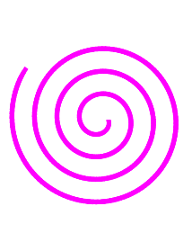
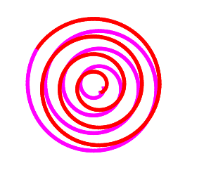
Different Animations:
function draw()
{
//context.clearRect(0,0, 400,400);
context.beginPath();
// Draws a circle of radius rad at the coordinates x,y on the canvas
context.lineWidth=5;
context.strokeStyle= col;
context.arc(x,y,rad,c1,c2,false);
context.stroke();
rad=rad+drad;
c1=c1+dc;
c2=c2+dc;
if (rad>100) {
clearInterval(myMove);
}
}

Slide 13
If we want to stop animation
var myMove;
context= myCanvas.getContext('2d');
function init()
{
myMove=setInterval(draw,20);
}
function draw()
{
//……
//….
if (rad>100) {
clearInterval(myMove);

Slide 14
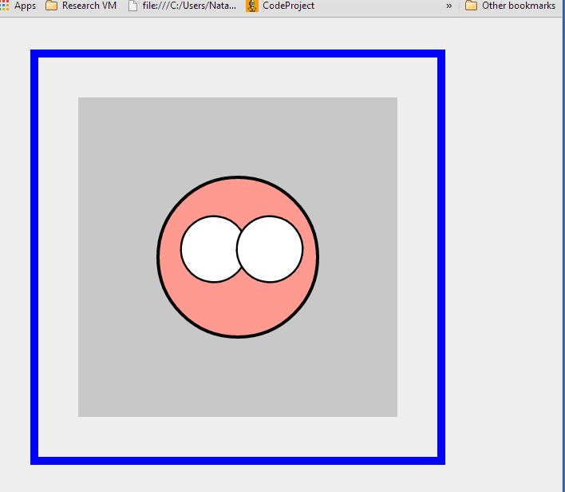
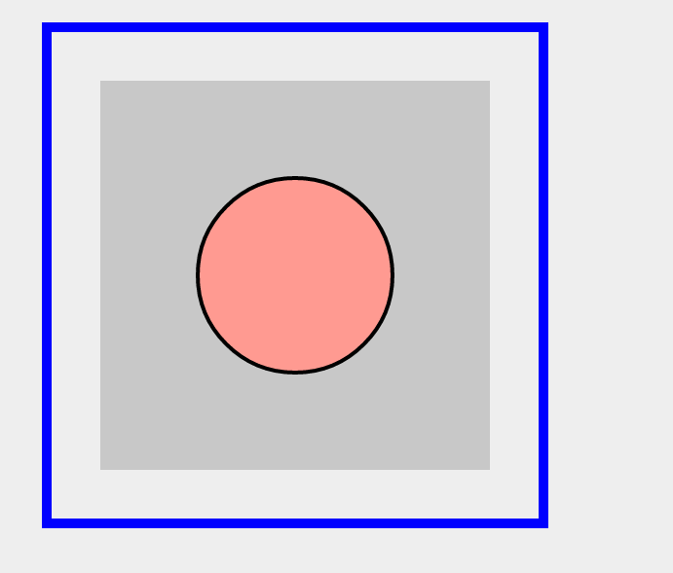


Animated Face:

Slide 15
Plan:
Animation on Canvas
Ball movement
Animated Gradient
Animated Spiral
Animated face

Slide 16
How to change cursor (css)
http://www.w3schools.com/cssref/tryit.asp?filename=trycss_cursor

Slide 17
Resources:
http://ie.microsoft.com/testdrive/Graphics/CanvasPad/Default.html
http://www.w3schools.com/html/html5_canvas.asp
http://www.webbingways.com/bookfiles/chapter3/codelisting_3_11.html

Slide 18
Example
http://www.webbingways.com/bookfiles/chapter3/codelisting_3_4.html

